Slide 1
Stand Your Ground With Payors
Presented by :
Sean M. Weiss CHC, CMCO, CPMA, CMPE, CPC-P, CPC
Vice President & Chief Compliance Officer

Slide 2
MEET THE PRESENTER
Sean M Weiss
Partner, VP & Chief of Compliance
DoctorsManagement, LLC

Slide 3
Bothra Case
UNITED STATES OF AMERICA, Plaintiff, v. D-1 RAJENDRA BOTHRA, D-4 DAVID LEWIS, D-5 CHRISTOPHER RUSSO, Defendants.
How 4 doctors beat the feds in botched $500 million pill mill case
4 Michigan doctors acquitted of charges in prescription drug scheme
Rajendra Bothra, Ganiu Edu, David Lewis, Christopher Russo acquitted after 6-week trial
Jury acquits Metro Detroit doctors feds accused of health care fraud scheme
In December 2018, Bothra, Edu, Lewis, Russo and two others were charged in a 56-count indictment with cheating Medicare and Medicaid out of nearly $500 million.
Authorities accused them of fueling the nation's opioid epidemic by illegally prescribing more than 13 million doses of prescription pain medication.
“Collectively, the defendants submitted, or caused to be submitted, over $182.5 million in claims to Medicare, $272.6 million to Medicaid, and over $9.2 million to Blue Cross/Blue Shield of Michigan,”
FBI agents seized at least $17.2 million from bank accounts linked to Bothra and his family, according to a forfeiture notice filed in federal court. His pain clinic also closed. In all, the FBI seized money from 19 bank accounts linked to Bothra and his team of doctors with at least $25.9 million.

Slide 4
Ruan v. United States (Supreme Court Ruling)
§ 841, the mens rea “knowingly or intentionally” applies to the statute's “except as authorized” clause. Judgment: Vacated and remanded, 9-0, in an opinion by Justice Breyer on June 27, 2022.
After a defendant produces evidence that he or she was authorized to dispense controlled substances, the Government must prove beyond a reasonable doubt that the defendant knew that he or she was acting in an unauthorized manner, or intended to do so.

Slide 5
KEY POINTS
Risk Mitigation – Pre-emptive areas to focus before an audit/investigation
How to effectively respond to an Additional Documentation Request (ADR)
When to engage legal counsel and the importance of privilege

Slide 6
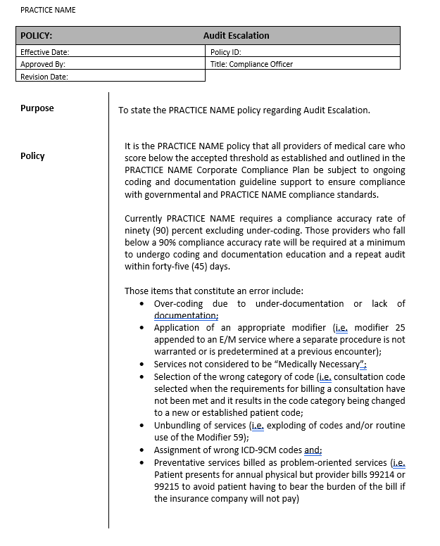
Giveaways: My Thanks for You Attending This Session!

Slide 7
“An aggravated assault on the English language"
How the Supreme Court characterized the Medicaid statute in a 1981 opinion, quoting a federal judge in New York

Slide 8
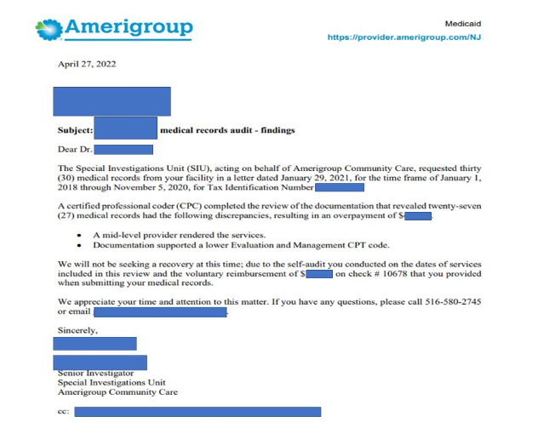
The Benefit of Proactive Compliance

Slide 9
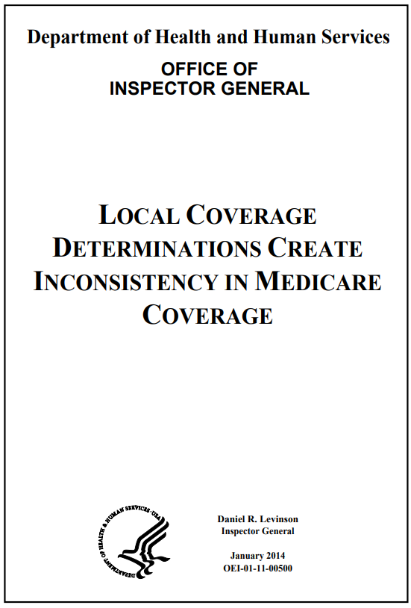
OIG 2014 LCD Report / Nothing Has Changed…
WHAT WE FOUND
In October 2011, over half of Part B procedure codes were subject to an LCD in one or more States. The presence of these LCDs was unrelated to the cost and utilization of items and services. Furthermore, LCDs limited coverage for these items and services differently across States. LCDs also defined similar clinical topics inconsistently. Finally, CMS has taken steps to increase consistency among LCDs, but it lacks a plan to evaluate new LCDs for national coverage as called for by the MMA.
WHAT WE RECOMMEND
We recommend that CMS establish a plan to evaluate new LCD topics for national coverage consistent with MMA requirements. We also recommend that CMS continue efforts to increase consistency among existing LCDs. Finally, we recommend that CMS consider requiring MACs to jointly develop a single set of coverage policies. CMS concurred with all of our recommendations.

Slide 10
Azar v. Allina Health System
The U.S. Supreme Court’s 2019 decision in Azar v. Allina Health Services effectively curtailed the enforceability of certain Medicare policies established without notice-and-comment rulemaking. As a result, health care fraud cases brought under the False Claims Act (FCA), which are predicated on sub-regulatory guidance, face heightened scrutiny after Allina.
In a recent Advisory Opinion, the Health and Human Services Office of the General Counsel (HHS-OGC) provided its interpretation of Allina and how violations of sub-regulatory guidance affect the ability of governmental enforcement agencies and relators to bring and support FCA actions moving forward. Specifically, on 3 December 2020, HHS-OGC issued Advisory Opinion 20-05 on Implementing Allina. While HHS-OGC considers the Advisory Opinion nonbinding and it lacks the force of law, the Advisory Opinion provides HHS-OGC’s current views on the implementation of Allina, specifically surrounding the definition and interpretation of a “substantive legal standard.” Key takeaways are as follows:
After Allina, policies that establish or change substantive legal standards related to the scope and award of benefits under the Medicare Act are likely unenforceable as predicates to FCA actions unless promulgated under the formal rulemaking process. Allina has cast doubt on the viability of many health care fraud claims commonly brought under the FCA.
The Advisory Opinion offers HHS-OGC’s interpretation of Allina, stating that claims citing to guidance that is closely tied to statutory or regulatory requirements may continue, however, guidance that creates policies or rules not closely tied to statutory or regulatory requirements cannot be the basis for an enforcement action.
Considering Allina, recent court opinions, and the Advisory Opinion, collectively, defendants facing FCA actions based solely on violations of sub-regulatory guidance may have a strong argument that falsity under the FCA cannot be established if the guidance is not tied directly to statutory or regulatory text and was issued without proper notice-and-comment rulemaking.
The impact of Allina on the Government’s and relators’ ability to pursue FCA actions predicated on improperly issued sub-regulatory guidance is unknown but key to that determination will be how narrowly guidance must be tailored to existing statutes or regulatory requirements.
Source: HHS OGC Weighs in on Sub-Regulatory Guidance in Advisory Opinion: What It Might Mean for False Claims Act Cases After Azar v. Allina Health Services | HUB | K&L Gates (klgates.com)

Slide 11
Sub-Regulatory Guidance
The difference between regulation and a guidance document?
Guidance documents must not set new legal standards or impose new requirements. Unlike regulations, guidance documents do not contain amendments to the Code of Federal Regulations and are not subject to the notice and comment process.
Guidance documents clarify and affect how agencies administer regulations and programs. However, they are not legally binding in the same way as rules issued through one of the rulemaking processes of the Administrative Procedure Act (APA).

Slide 12
Ex Post Facto Laws – After the Fact; retrospectively
“Both federal and state governments are prohibited from enacting ex post facto laws and the Court applies the same analysis whether the law in question is a federal or a state enactment.
When these prohibitions were adopted as part of the original Constitution, many persons understood the term ex post facto laws to “embrace all retrospective laws, or laws governing or controlling past transactions, whether . . . of a civil or a criminal nature.”
Every law that makes criminal an act that was innocent when done, or that inflicts a greater punishment than the law annexed to the crime when committed, is an ex post facto law within the prohibition of the Constitution”.

Slide 13
Ex Post Facto Law – Continued
There are three categories of ex post facto laws:
“those “which punish as a crime an act previously committed, which was innocent when done;
which make more burdensome the punishment for a crime, after its commission; or
which deprive one charged with crime of any defense available according to law at the time when the act was committed.”

Slide 14
SIUs, Contractors and MACs
All are bound by contractual obligations and others are bound by Statute, Regs, Acts and Laws
Bottomline – you have to hold them accountable and not allow them to paint with broad brush strokes or to create a narrative that fits a suspected violation.
Knowing your rights and what they are bound to goes a long way to ensuring a level-playing-field.
Contracts/Governing Documents and Policies for each payer with which you participate
3.3.1.1 – Medical Record Review – (Rev. 10228; Issued: 07-27-20; Effective: 08-27-20; Implementation: 08-27-20)
Medical Necessity – Defined by CMS, In Kaminski and in General
Clinical Review Judgement as defined by CMS
Treating Physician Rule – Not used in Social Security or Disability but often used in CMS cases
§1870(b) of the Act. – Overpaid Provider Not Liable Because It Was Without Fault

Slide 15
Contract/Governing Documents and Policies
These are crucial to any appeal/dispute with a payer.
Providers and their leadership team must understand:
what is in your participation agreements;
when they expire or if they automatically roll-over;
what rate(s) you are reimbursed under;
How they define “medical necessity”;
Policies for top services billed to each payer and in the absence of an LCD/MCP, etc. how are disputes handled

Slide 16
OIG Work Plan & Active Work Plan Items

Slide 17
Liar, Liar, Pants on Fire…

Slide 18
Busted

Slide 19
Disgraced and Dismissed

Slide 20
Compliance Programs for Physicians
Establishing and following a compliance program will help physicians avoid fraudulent activities and ensure that they are submitting true and accurate claims.
Core Elements of a Compliance Program
Conduct internal monitoring and auditing.
Implement compliance and practice standards.
Designate a compliance officer or contact.
Conduct appropriate training and education.
Respond appropriately to detected offenses and develop corrective action.
Develop open lines of communication with employees.
Enforce disciplinary standards through well-publicized guidelines.
With the passage of the Patient Protection and Affordable Care Act of 2010, physicians who treat Medicare and Medicaid beneficiaries will be required to establish a compliance program.

Slide 21
My Office Manager oR Physician Owner Won’t Believe Me!

Slide 22
The Federal Register

Slide 23
The Facts
The Patient Protection and Affordable Care Act of 2010 (the “Healthcare Reform Act,” or the “Act”) was signed into law on March 23, 2010.
The Act:
requires closer scrutiny of providers and suppliers seeking to participate in Medicare and other federally funded healthcare programs
allows for the collection and centralization of billing and claims data and makes that information available to law enforcement and oversight agencies for the purpose of investigating suspected fraud
increases the penalties for those who abuse the system
amends the False Claims Act and the Anti-kickback Act to make it easier for the government to bring actions under those statutes
provides substantial amounts in additional resources to government agencies, investigators, and prosecutors to pursue wrongdoers

Slide 24
Mandatory Compliance
Section 6401(a)(7) of the Act requires providers and suppliers enrolled in federal healthcare programs to create and maintain compliance programs as a condition of their continued participation.
This Section directs the Department of Health and Human Services (HHS), in consultation with the HHS Office of Inspector General (HHS-OIG) to establish the “core elements” of such programs through regulation and to determine the timeline for implementing compliance programs.
Further, the Act empowers HHS to disenroll non-compliant providers and suppliers and/or to impose civil monetary penalties or other Immediate sanctions.
The Act requires screening before providers or suppliers can participate in Medicare.
HHS has the authority to establish such screening procedures which shall include state licensure checks, criminal background checks, fingerprinting, unscheduled and unannounced site visits, database checks and other such screening as HHS deems appropriate.

Slide 25
Civil Monetary Penalties Law (CMPLs)
The Act amends the civil monetary penalties statute to include a penalty of up to $50,000 for false statements, omissions, or misrepresentations made in any application or contract to participate or enroll as a supplier or provider under a federal healthcare program.
Violators will also be required to pay three times any amounts claimed as a result of the false statement.
Penalties will also be assessed against a person who, while excluded from participating in federal healthcare programs, prescribes covered items or services if he or she “knew or should have known” that a claim for the item or service would be made to Medicare or Medicaid.

Slide 26
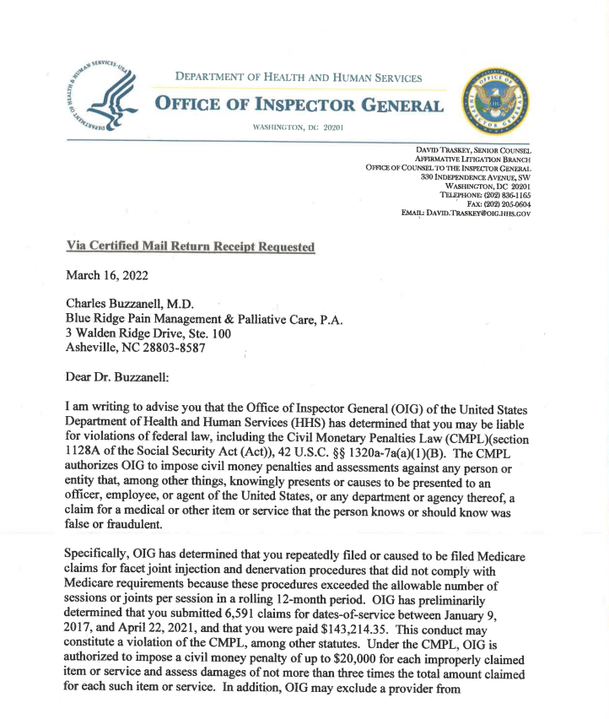
This is a pre-investigation notice… Basically, come in and let’s discuss settlement

Slide 27
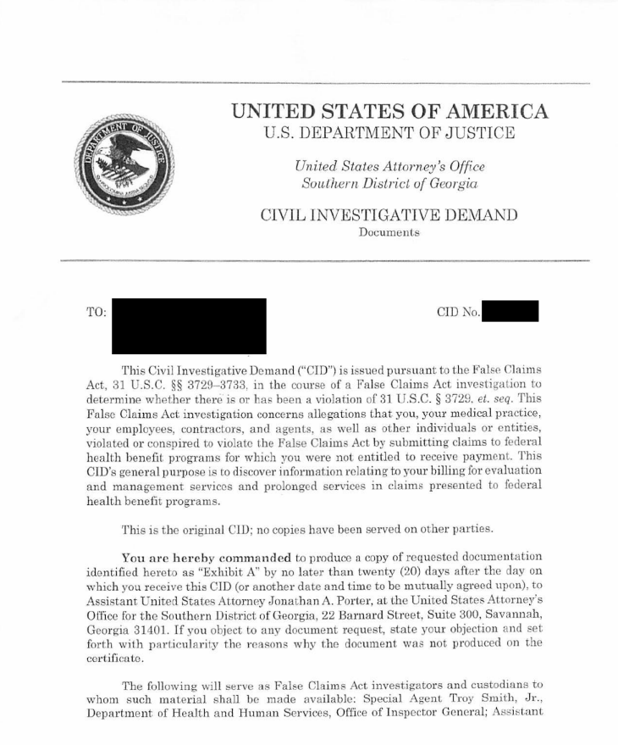

Slide 28
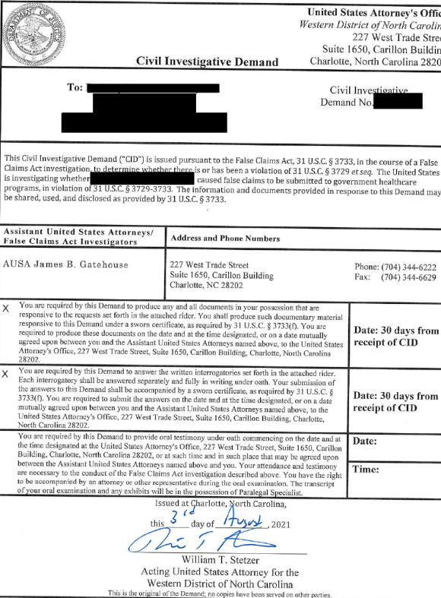

Slide 29
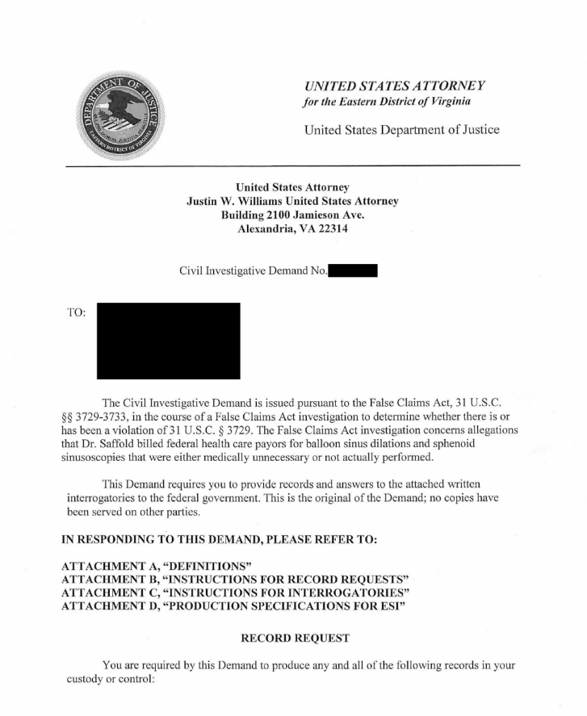

Slide 30
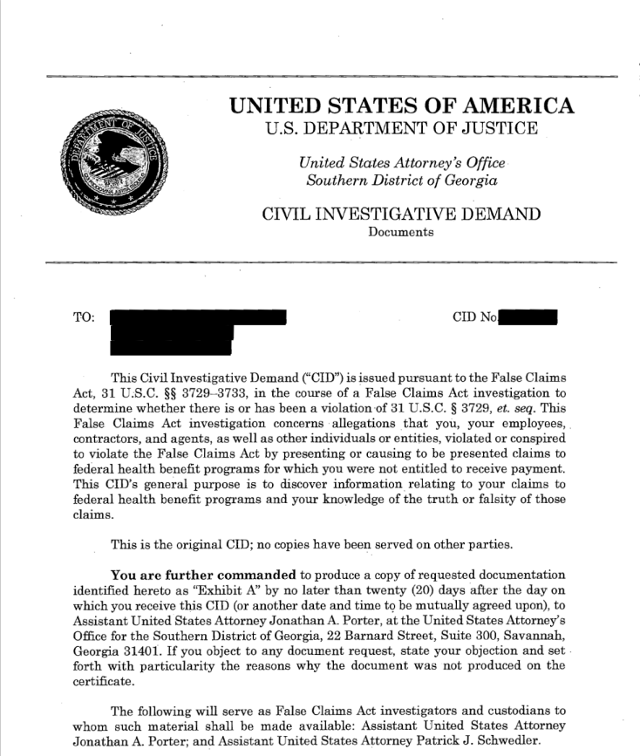

Slide 31
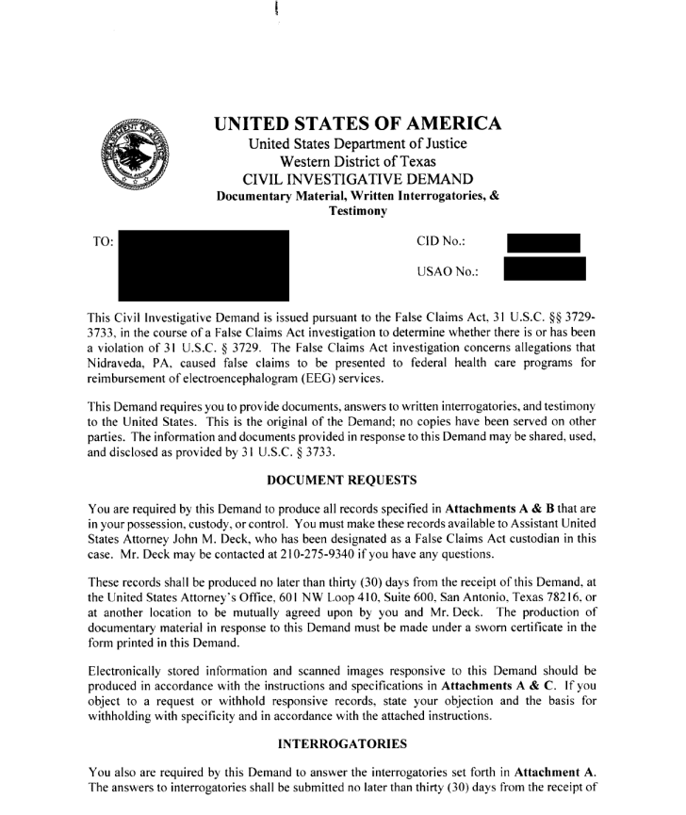

Slide 32
Overpayment Requirement & False Claims Act
The Act mandates that any overpayments must be both reported and returned within 60 days of discovery.
If the overpayment is not returned it becomes an “obligation” that subjects the provider to substantial liability under the False Claims Act.
The Act limits the “public disclosure bar” to federal criminal, civil or administrative hearings, audits or investigations. Meaning:
the Act overrules a recent Supreme Court decision holding that disclosures in state proceedings also could bar subsequent False Claims Act cases.
the Act gives the Department of Justice the authority to oppose dismissal of an action even where allegations are publicly disclosed, and the relator does not qualify as an original source of the underlying information.

Slide 33
3.3.1.1 – Medical Record Review
3.3.1.1 - Medical Record Review (Rev. 10228; Issued: 07-27-20; Effective: 08-27-20; Implementation: 08-27-20) This section applies to MACs, CERT, RACs, Supplemental Medical Review Contractor(s) and UPICs, as indicated.
Clinical Review Judgment involves two steps:
The synthesis of all submitted medical record information (e.g. progress notes, diagnostic findings, medications, nursing notes, etc.) to create a longitudinal clinical picture of the patient; and
The application of this clinical picture to the review criteria is to make a reviewer determination on whether the clinical requirements in the relevant policy have been met. MAC, CERT, RAC, and UPIC clinical review staff shall use clinical review judgment when making medical record review determinations about a claim.
Clinical review judgment does not replace poor or inadequate medical records. Clinical review judgment by definition is not a process that MACs, CERT, RACs and UPICs can use to override, supersede or disregard a policy requirement. Policies include laws, regulations, the CMS’ rulings, manual instructions, MAC policy articles attached to an LCD or listed in the Medicare Coverage Database, national coverage decisions, and local coverage determinations.

Slide 34
Credentials of Reviewers
The MACs, MRAC, and CERT shall ensure that medical record reviews for the purpose of making coverage determinations are performed by licensed nurses (RNs), therapists or physicians. Current LPNs may be grandfathered in and can continue to perform medical record review. The MACs, MRAC, and CERT shall not hire any new LPNs to perform medical record review. UPICs, RACs and the SMRC shall ensure that the credentials of their reviewers are consistent with the requirements in their respective SOWs.
During a medical record review, nurse and physician reviewers may call upon other health care professionals (e.g., dieticians or physician specialists) for advice. The MACs, MRAC, and CERT, shall ensure that services reviewed by other licensed health care professionals are within their scope of practice and that their MR strategy supports the need for their specialized expertise in the adjudication of particular claim type (i.e., speech therapy claim, physical therapy). RACs and the SMRC shall follow guidance related to calling upon other healthcare professionals as outlined in their respective SOWs.
RACs shall ensure that a licensed medical professional will perform medical record reviews for the purpose of determining medical necessity, using their clinical review judgment to evaluate medical record documentation. Certified coders will perform coding determinations. CERT and MACs are encouraged to make coding determinations by using certified coders. UPICs have the discretion to make coding determinations using certified coders.

Slide 35
Credential Files
The MACs, MRAC, CERT, RACs, and UPICs shall maintain a credentials file for each reviewer (including consultants, contract staff, subcontractors, and temporary staff) who performs medical record reviews. The credentials file shall contain at least a copy of the reviewer’s active professional license.

Slide 37
AMA Definition of Risk – When Clinical and Non-Clinical Review Deployed by Payer
“Definitions of risk are based upon the usual behavior and thought processes of a physician or other qualified health care professional in the same specialty (This is why we request the credentials for the physician reviewer in this case). For the purposes of medical decision making, level of risk is based upon consequences of the problem(s) addressed at the encounter when appropriately treated. Risk also includes medical decision making related to the need to initiate or forego further testing, treatment and/or hospitalization.”

Slide 38
Medical Necessity
“Medically Necessary” or “Medical Necessity” shall mean health care services that a physician, exercising prudent clinical judgment, would provide to a patient for the purpose of preventing, evaluating, diagnosing or treating an illness, injury, disease or its symptoms, and that are: a) in accordance with generally accepted standards of medical practice; b) clinically appropriate, in terms of type, frequency, extent, site and duration, and considered effective for the patient's illness, injury or disease; and c) not primarily for the convenience of the patient, physician or other health care provider, and not more costly than an alternative service or sequence of services at least as likely to produce equivalent therapeutic or diagnostic results as to the diagnosis or treatment of that patient's illness, injury or disease.
For these purposes, “generally accepted standards of medical practice” means standards that are based on credible scientific evidence published in peer‐reviewed medical literature generally recognized by the relevant medical community or otherwise consistent with the standards set forth in policy issues involving clinical judgment.

Slide 39
Understanding How to Defend “Medical Necessity”
Unless the contrary is specified, the term “Medical Necessity” must refer to what is medically necessary for a particular patient, and hence entails an individual assessment rather than a general determination of what works in the ordinary case.
Second Circuit Court of Appeals, cited in Kaminski, Defining Medical Necessity, http://www.cga.ct.gov/2007/rpt/2007-r-0055.htm

Slide 40
Medicare’s View of “Medical Necessity”
In the Medicare program, “Medical Necessity” is defined under Title XVIII of the Social Security Act, Section 1862 (a) (1) (a): “Notwithstanding any other provision of this title, no payment may be made under part A or part B for any expenses incurred for items or services which, except for items and services described in a succeeding subparagraph, are not reasonable and necessary for the diagnosis or treatment of illness or injury or to improve the functioning of a malformed body member.”
The above is a legal doctrine by which evidence-based clinical standards are used to determine whether a treatment or procedure is reasonable, necessary and/or appropriate.

Slide 41
HOW DO WE DEFEND MEDICAL NECESSITY
Documentation within the Medical Record:
Does “Medical Necessity” exist or likely exist but the issue is lacking documentation in the medical record?
Physicians have a responsibility to provide sufficient documentation that paints a clear picture of each and encounter
Determining whether the procedures in question are truly clinically necessary or if the issue is documentation related is critical to the defense of the investigation
Make sure that all relevant medical records have been retrieved and reviewed. This means office notes, hospital notes, nursing home, rehabilitation, etc.
Do LCDs or NCDs exist to provide documentation requirements?
If the allegations are that documentation is inaccurate, have we generated clinical rebuttals to further clarify the need for services and state the physicians opinion clearly.

Slide 42
Clear and Binding Medical Necessity Standard
The Medicare statute requires that any “rule, requirement, or other statement of policy (other than a material coverage decision) that establishes or changes a substantive legal standard” must be promulgated by regulation. 42 U.S.C § 1395hh.
Has CMS promulgated a standard for determining whether a service is reasonable and necessary?
Courts FROM TIME TO TIME give deference to the determination of the “Treating physician” (United States v. Prabhu, 442 F. Supp 2d 1008 (D. Nev 2006) – The Treating Physician Rule was removed from SSA Regulations Effective March, 27, 2017
Clarity of Medical Necessity issues affect whether a claim is False and whether the requisite “knowledge” exists.
“Claims are not ‘false’ under the FCA when reasonable persons can disagree regarding whether the service was properly billed to the Government.” Prabhu
“a Defendant does not ‘knowingly’ submit a ‘false’ claim when his conduct is consistent with a reasonable interpretation of ambiguous regulatory guidance.” Prabhu

Slide 43
Treating Physician Rule
Treating Physicians ‐‐ The first section of the Medicare statute is the prohibition “Nothing in this title shall be construed to authorize any Federal officer or employee to exercise any supervision or control over the practice of medicine or the manner in which medical services are provided.”
From this, one could conclude that the beneficiary's physician should decide what services are medically necessary for the beneficiary, and a substantial line of authority in the Social Security disability benefits area holds that the treating physician's opinion is entitled to special weight and is binding upon the Secretary when not contradicted by substantial evidence.
Some courts have applied the rationale of the "treating physician" rule in Medicare cases, and have rejected the Secretary's assertion that the treating physician rule should not be applied to Medicare determinations.

Slide 44
Treating Physician Rule ContINUEd
In Holland vs. Sullivan, the court concluded:
Though the considerations bearing on the weight to be accorded a treating physician's opinion are not necessarily identical in the disability and Medicare context, we would expect the Secretary to place significant reliance on the informed opinion of a treating physician and either to apply the treating physician rule, with its component of "some extra weight" to be accorded that opinion, [even if contradicted by substantial evidence], or to supply a reasoned basis, in conformity with statutory purposes, for declining to do so.

Slide 45
Judgement Error
“If the overpayment is the result of the insurance company changing its judgment after paying the claim -- determining the service was outside the scope of the insured's coverage plan, for example -- providers may not be obligated to reimburse the insurance company.”
Many state courts have decided insurance companies are not entitled to reimbursement if the provider made no misrepresentations to prompt the payment and had no reason to suspect the payment was in error.
However, the provider cannot keep any payment that would be considered beyond the scope of the service.

Slide 46
Sustained or High Error Rate
Determining When a Statistical Sampling May Be Used. Under the new guidance, a contractor “shall use statistical sampling when it has been determined that a sustained or high level of payment error exists. The use of statistical sampling may be used after documented educational intervention has failed to correct the payment error.” This guidance now creates a three-tier structure:
Extrapolation shall be used when a sustained or high level of payment error exists.
Extrapolation may be used after documented educational intervention (such as in the Targeted Probe and Educate (TPE) program).
It follows that extrapolation should not be used if there is not a sustained or high level of payment error or evidence that documented educational intervention has failed.
What is a “sustained or high level of payment error?” The PIM now specifies this can be when the sample review error rate is “greater than or equal to 50[%].” This is a significant difference from error rates Medicare auditors have previously used to justify a high error rate and may provide some relief as to the punitive effects of extrapolation.
However, the “50% or greater” test is not the only method CMS permits to determine a sustained or high level of payment error. The TPE Program differs in that it ranges from 15 – 20% billed error rate.
The PIM also states that the contractor may look to the provider’s history of noncompliance for the same or similar billing issues, or a historical pattern of noncompliant billing practice.

Slide 47
The Medicare Appeals Process
Areas to Focus:
Determine whether the overpayment was improper;
Determine if you were actually paid for the claim(s);
Current and future reimbursement risk should be determined through internal audits;
If errors are identified take corrective action via CAP;
Determine the cost of engaging professionals to handle the appeal process. This should be broken down by stage;
Determine whether source information exists regarding Medicare reimbursement policy and review to see if it helps or hurts your position (e.g., regulations, National Coverage Determinations, Local Coverage Determinations, professional journals, articles, etc.); and
Determine whether the claims were erroneous or if potential for Fraud exists.

Slide 48
The Medicare Appeals Process
Pitfalls to Avoid:
Don’t jump to the conclusion your issue(s) require a self-disclosure protocol. Issues can often be remedied through a corrected claims process;
Filing an appeal based on principal rather than facts and potential outcomes. Engaging the appeals process when its more intelligent and cheaper to make a refund and avoid additional costs;
Missing filing deadlines;
Providing limited analysis; and
Failing to fix identified problems going forward.

Slide 49
§1870(b) of the Act
Medicare Intermediary Manual Part 3 – Claims Process – Transmittal 1829
D. Overpaid Provider Not Liable Because It Was Without Fault (§1870(b) of the Act.).-- If a provider was without fault with respect to an overpayment it received (or is deemed without fault, in the absence of evidence to the contrary, because the overpayment was discovered subsequent to the third calendar year after the year of payment) it is not liable for the overpayment; therefore, it is not responsible for refunding the amount involved. You make these determinations. This provision forms the basis for policies and instructions in §§3708, 3708.1, 3708.2, 3708.4, and 3708.6.

Slide 50
Sec. 1870. [42. U.S.C. 1395gg]:
“(c) There shall be no adjustment as provided in subsection (b) (nor shall there be recovery) in any case where the incorrect payment has been made (including payments under section 1814(e)) with respect to an individual who is without fault or where the adjustment (or recovery) would be made by decreasing payments to which another person who is without fault is entitled as provided in subsection (b)(4), if such adjustment (or recovery) would defeat the purposes of title II or title XVIII or would be against equity and good conscience. Adjustment or recovery of an incorrect payment (or only such part of an incorrect payment as the Secretary determines to be inconsistent with the purposes of this title) against an individual who is without fault shall be deemed to be against equity and good conscience if
(A) the incorrect payment was made for expenses incurred for items or services for which payment may not be made under this title by reason of the provisions of paragraph (1) or (9) of section 1862(a) and
(B) if the Secretary’s determination that such payment was incorrect was made subsequent to the fifth year following the year in which notice of such payment was sent to such individual; except that the Secretary may reduce such five-year period to not less than one year if he finds such reduction is consistent with the objectives of this title.”

Slide 51
Overpayment Requirement & False Claims Act
The Act mandates that any overpayments must be both reported and returned within 60 days of discovery.
If the overpayment is not returned it becomes an “obligation” that subjects the provider to substantial liability under the False Claims Act.
The Act limits the “public disclosure bar” to federal criminal, civil or administrative hearings, audits or investigations. Meaning -
the Act overrules a recent Supreme Court decision holding that disclosures in state proceedings also could bar subsequent False Claims Act cases.
the Act gives the Department of Justice the authority to oppose dismissal of an action even where allegations are publicly disclosed, and the relator does not qualify as an original source of the underlying information.

Slide 52
Healthcare Fraud Criminal Offense
The Act amends 18 U.S.C. 1347 (criminal healthcare fraud) to eliminate any requirement that the defendant have “actual knowledge” of the healthcare fraud statute or specific intent to violate it.
Sources slides 6-10
Patient Protection and Affordable Care Act of 2010, H.R. 3590, March 23, 2010.
H.R. 3590, Sec. 6401 (a)(7).
H.R. 3590, Sec. 6401 (a)(7).
H.R. 3590, Sec. 6401 (a)(7).
http://oig.hhs.gov/fraud/complianceguidance.asp
2009 United States Sentencing Commission Guidelines Manual, §8B2.1 Effective Compliance and Ethics Program (2009).
H.R. 3590, Sec. 6401 (a).
H.R. 3590, Sec. 10104(j).
H.R. 3590, Sec. 10104(j).
H.R. 3590, Sec. 10104(j).
H.R. 3590, Sec. 10606.

Slide 53
2022 Areas of Focus
OIG, CMS and Commercial Payer Areas of Focus;
Evaluation and Management Services
Amniotic Fluid for MSK
Medical Necessity
Cloning and Clinical Plagiarism
Infusion Services
Evaluation and Management Services and Application of 25 modifier
Incident-to & Split Shared Services

Slide 54
2021 E/M Changes
The Changes to the 2021 E/M Codes are applicable to only Office or Other Outpatient Service Codes 99202 – 99215 (99201 has been deleted). Hospital and other E/M codes are not impacted by the changes.
History and Exam
Will no longer be scored (elements counted), but they still have to be present in the note and support medical necessity
MDM
Encounter Diagnosis
Only diagnoses documented as active treatment during the present encounter will be considered for scoring purposes
Data & Complexity
There will be new requirements for specific combinations of different work elements to support a specific level
Table of Risk
The entire table of risk has been consolidated into one column on a new MDM grid and uses only the last column of treatment options for the patient
Time
The visit will no longer have to be dominated by counseling/coordination of care
Time spent now includes the rendering providers total time spent including non-face-to-face time spent specific to the encounter and patient
Remember that medical necessity is still going to have to be reflected within the documentation of each encounter!

Slide 55
Evaluation and Management Services
Medical Necessity as it relates to coding – 30.6.1 – Evaluation and Management Services – Medical Necessity is the overarching criteria in addition to the individual elements of the CPT Codes
History
Medical Necessity and how we use it to determine the level of intensity for an encounter
Chief Complaint
History – Focus on the History of Present Illness / the history should be clinically relevant
Exam – It needs to be clinically relevant
Medical-Decision Making – This has changed in 2021. Expect further guidance from the MACs and CMS in the coming months.

Slide 56
Defining “Medical Necessity”
“Medically Necessary” or “Medical Necessity” shall mean health care services that a physician, exercising prudent clinical judgment, would provide to a patient for the purpose of preventing, evaluating, diagnosing or treating an illness, injury, disease or its symptoms, and that are: a) in accordance with generally accepted standards of medical practice; b) clinically appropriate, in terms of type, frequency, extent, site and duration, and considered effective for the patient's illness, injury or disease; and c) not primarily for the convenience of the patient, physician or other health care provider, and not more costly than an alternative service or sequence of services at least as likely to produce equivalent therapeutic or diagnostic results as to the diagnosis or treatment of that patient's illness, injury or disease.
“Generally accepted standards of medical practice” means standards that are based on credible scientific evidence published in peer‐reviewed medical literature generally recognized by the relevant medical community or otherwise consistent with the standards set forth in policy issues involving clinical judgment.

Slide 57
The False Claims Act
Under the FCA, a person is deemed to have acted “knowingly” when the person “acts in deliberate ignorance of the truth or falsity of the information; or acts in reckless disregard of the truth or falsity of the information.”
31 U.S.C. § 3729(b).
As the Ninth Circuit has pointed out, the FCA knowledge standard does not extend to honest mistakes, but only to “lies.” “Claims are not ‘false’ under the FCA unless they are furnished in violation of some controlling rule, regulation or standard”.
See, e.g., United States ex rel. Local 342 v. Caputo Co., 321 F.3d 926, 933 (9th Cir.2003); United States v. Southland Mgmt. Corp., 326 F.3d 669, 674-75 (5th Cir.2003) (“[W]hether a claim is valid depends on the contract, regulation, or statute that supposedly warrants it.
It is only those claims for money or property to which a Defendant is not entitled that are ‘false’ for purposes of the False Claims Act”) (citation omitted) (en banc);
United States ex rel. Hochman v. Nackman, 145 F.3d 1069, 1073-74 (9th Cir.1998) (no falsity when Defendants' acts conformed with Veteran Administration payment guidelines);
United States ex rel. Lindenthal v. Gen. Dynamics Corp., 61 F.3d 1402, 1412 (9th Cir.1995) (whistleblower's FCA claims for payment based on work that satisfied contractual obligations “could not have been ‘false or fraudulent’ within the meaning of the [False Claims Act]”);
United States ex rel. Glass v. Medtronic, Inc., 957 F.2d 605, 608 (8th Cir.1992) (a statement cannot be “false” or “fraudulent” under FCA when the statement is consistent with regulations governing program).
Additionally, a Defendant does not knowingly submit false claims when he follows Government instructions regarding the claims. See United States ex rel. Butler v. Hughes Helicopters, Inc., 71 F.3d 321 (9th Cir.1995); Wang v. FMC Corp., 975 F.2d 1412, 1421 (9th Cir.1992).

Slide 58
Determining Medical Necessity
Clinical Review Judgment
Clinical review judgment involves two steps:
The synthesis of all submitted medical record information (e.g. progress notes, diagnostic findings, medications, nursing notes, etc.) to create a longitudinal clinical picture of the patient and,
The application of this clinical picture to the review criteria is to make a reviewer determination on whether the clinical requirements in the relevant policy have been met. MAC, CERT, RAC, and ZPIC/UPIC clinical review staff shall use clinical review judgment when making medical record review determinations about a claim.

Slide 59
Incident-to
I-2 Services and the specifics:
Direct Supervision
Immediately Available
Treatment Plan must be established by a Physician
Changes to a treatment plan made by the NPP results in the visit being billed under their number

Slide 60
Split Shared Service
CMS made significant changes to longstanding policies for split (or shared) E/M visits. Critical care services and certain visits occurring in skilled and non-skilled nursing facilities, which previously had been excluded, will be eligible for split (or shared) billing beginning January 1, 2022.
CMS changed the definition of a “substantive portion” of a split/shared service, which is used to determine if a claim for a service jointly performed by a PA (or NP) and physician can be billed under the physician’s name and National Provider Identifier (NPI) number.
Medicare payment is made at 100 percent when billed under the physician’s name as opposed to 85 percent if billed under the name of a PA or NP.
In order for the services to be billable under the physician’s name, the physician must perform a substantive portion of the service. For 2022, a substantive portion of the service by a physician is defined as:
1) the physician personally performing either the history, exam, or medical decision making (in its entirety), or
2) the physician spending more than half of the total time by both the physician and the PA (or NP) on face-to-face and non-face-to-face patient care activities.
For services already defined as time-based such as critical care and discharge management, the substantive portion of care can only be determined based on which health professional spent more than half the combined time providing care to the patient.

Slide 61
Split Shared Service continued
For services already defined as time-based such as critical care and discharge management, the substantive portion of care can only be determined based on which health professional spent more than half the combined time providing care to the patient.
Beginning in 2023, only time will be used to define a substantive portion of care which means the health professional who spends the majority of time providing care to the patient is the one under whom the service should be billed.
Other requirements that must be met for a physician to bill a service as split/shared under their name/NPI
The physician and PA (or NP) must work for the same group
The physician and PA (or NP) must see the patient on the same calendar day
The services must be performed in a hospital, facility, or hospital outpatient office
Documentation in the medical record must identify the physician and nonphysician practitioner who performed the visit. The individual who performed the substantive portion of the visit (and therefore bills for the visit) must sign and date the medical record
CMS plan to require a modifier that will be required to be placed on split (or shared) claims to inform future policy considerations and help ensure program integrity. That modifier code has not yet been released.

Slide 62
Medicaid and Medicare 72 Hour Rule
Kentucky’s Medicaid rule regarding authentication of medical records and timing requirements. 907 Kentucky Administrative Regulations (KAR) 1:102 §2(4)(b)2 states: “The individual who provided the service shall date and sign the health record within seventy-two (72) hours from the date that the individual provided the service.” Kentucky implemented this rule effective on July 6, 2015.
Alaska 72 Hour Contemporaneous Documentation FAQs
Q1. Please clarify the 72-hour requirement for documentation of services; is this a straight 72 hours or is its 72 business hours. The 72-hour requirement applies to the initial documentation of services. The regulation states 72 hours from the end date of service. This is a straight 72 hours from the end of date of service.
An example is the date of service is June 15, 2018, the 72-hour clock starts at 12:00 am June 16, 2018, and is to be documented by 11:59 pm June 18, 2018.
Q2. What about weekends and holidays? The 72-hour requirement does not allow an extension for weekends and holidays.
Noridian - Q3. After a service has been rendered, what amount of time is acceptable to Medicare for the doctor to sign the notes?
A3. In most cases, Noridian expects that the notes are signed at the time services are rendered. Further delays may require an explanation. See CMS Internet Only Manual (IOM), Publication 100-08, Medicare Program Integrity Manual, Section 3.3.2.5

Slide 63
Signature Requirements
CMS’s vague guidance is found in Chapter 12 of the Manual in the following statement, “The service should be documented during, or as soon as practicable after it is provided in order to maintain an accurate medical record.”
Check with your MAC. Some give reasonable direction:
WPS which states, “A reasonable expectation would be no more than a couple of days away from the service itself.”
Noridian states that they expect, “In most cases the notes would be signed at the time services are rendered.”
Palmetto is a little more direct stating, “Providers should not add a late signature to the medical record, (beyond the short delay that occurs during the transcription process).” It is understood that there are circumstances, like waiting for transcription to be complete that might preclude signing the record at the time of service. In general, it is best to sign the record at the time of service, if not within a day or two at the latest.
You may not add late signatures to orders or medical records (beyond the short delay that occurs during the transcription process). MLN Fact Sheet – Complying with Medicare Signatures - ICN 905364 May 2018

Slide 64
FCSO memo (see pages 3-6), followed by practical compliance tips that apply to each issue raised.
Medicare Comment No. 1
“Medicare expects the documentation to be generated at the time of service or shortly thereafter. Delayed entries within a reasonable time frame (24 to 48 hours) are acceptable for purposes of clarification, error correction, the addition of information not initially available, and if certain unusual circumstances prevented the generation of the note at the time of service.”
Medicare Comment No. 2
“The medical record cannot be altered. Errors must be legibly corrected so that the reviewer can draw an inference as to their origin. These corrections or additions must be dated, preferably timed, and legibly signed or initialed.”
Medicare Comment No. 3
“Every note must stand alone, i.e., the performed services must be documented at the outset. Delayed written explanations will be considered. They serve for clarification only and cannot be used to add and authenticate services billed and not documented at the time of service or to retrospectively substantiate medical necessity. For that, the medical record must stand on its own with the original entry corroborating that the service was rendered and was medically necessary.”
Medicare Comment No. 5
“Documentation is considered cloned when each entry in the medical record for a patient is worded exactly alike or similar to the previous entries. Cloning also occurs when medical documentation is exactly the same from patient to patient. It would not be expected that every patient had the exact same problem, symptoms, and required the exact same treatment.”
“Cloned documentation does not meet medical necessity requirements for coverage of services rendered due to the lack of specific, individual information. All documentation in the medical record must be specific to the patient and her/his situation at the time of the encounter. Cloning of documentation is considered a misrepresentation of the medical necessity requirement for coverage of services. Identification of this type of documentation will lead to denial of services for lack of medical necessity and recoupment of all overpayments made.”

Slide 65
Cloning
The word 'cloning' refers to documentation that is worded exactly like previous entries. This may also be referred to as 'cut and paste', copy and paste, or 'carried forward.' Cloned documentation may be handwritten, but generally occurs when using a preprinted template or a Promoting Interoperability (PI) Programs electronic record.
Promoting Interoperability (PI) Programs electronic records replace traditional paper medical records with computerized record keeping to document and store patient health information. EHRs may include patient demographics, progress notes, medications, medical history, and clinical test results from any health care encounter.
While these methods of documenting are acceptable, it would not be expected the same patient had the same exact problem, symptoms, and required the exact same treatment or the same patient had the same problem/situation on every encounter. Authorship and documentation in an EHR must be authentic.
Cloned documentation does not meet medical necessity requirements for coverage of services. Identification of this type of documentation will lead to denial of services for lack of medical necessity and recoupment of all overpayments made.
Over-documentation is the practice of inserting false or irrelevant documentation to create the appearance of support for billing higher level services. Some PI Programs technologies auto-populate fields when using templates built into the system. Other systems generate extensive documentation on the basis of a single click of a checkbox, which if not appropriately edited by the provider may be inaccurate.

Slide 67
Questions?
Sean M Weiss
Partner, VP & Chief Compliance Officer – DoctorsManagement, LLC
sweiss@drsmgmt.com
770.402.0855

