Slide 1
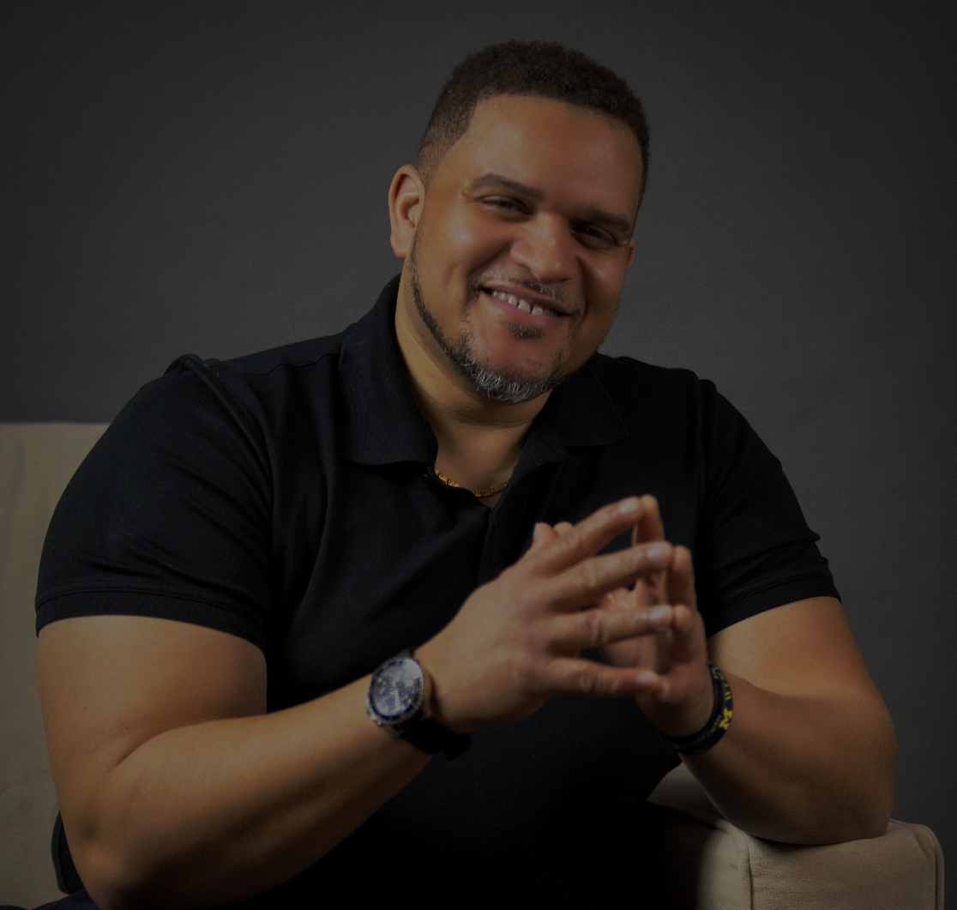
Welcome!
Connect with Adam…
Facebook: @AdamWhiteSpeaks
Twitter: @adamwhitespeaks
YouTube: Adam White Channel
LinkedIn: Adam H. White III
Web: adamwhitespeaks.com
Text Your Name & Email Address to
(734) 756-9114

Slide 2
NOW I AM THE VOICE
I WILL LEAD AND NOT FOLLOW.
I WILL BELIEVE AND NOT DOUBT.
I WILL CREATE AND NOT DESTROY
I AM A FORCE FOR GOOD.
I AM A LEADER.
I WILL DEFY THE ODDS!
I WILL SET A NEW STANDARD!
I WILL STEP UP!
I CAN, I WILL, I MUST

Slide 3
THE “DNA” OF GREAT LEADERSHIP
ADAMWHITE
Purpose-Driven Leadership
adamwhitespeaks.com
Leadership Authority | Motivational Speaker | Author | Strategist
ADAMWHITE

Slide 4
Knowledge is NOT power…
“APPLIED” knowledge is POWER!!!
ADAMWHITE

Slide 5
LEADERSHIP PRINCIPLES
ADAMWHITE

Slide 6
7 REASONS WHY WE NEED LEADERSHIP
Nothing “Happens” without Leadership
Nothing “Begins” without Leadership
Nothing “Improves” without Leadership
Nothing “Develops” without Leadership
Nothing “Changes” without Leadership
Nothing “Progresses” without Leadership
Nothing “Succeeds” without Leadership
ADAMWHITE

Slide 7
EVERY HUMAN BEING WAS BORN TO BE A LEADER
AREA OF GIFTING NOT OVER PEOPLE
YOUR GIFT AS A LEADER IS WHAT ATTRACTS PEOPLE TO YOUR LEADERSHIP
LEADERSHIP IS TRAPPED IN EVERY FOLLOWER…
ADAMWHITE

Slide 8
The Measurement of Leadership Greatness
“Leadership Greatness is not measured by how many people serve them, but by how many people a Leader serves”
ADAMWHITE

Slide 9
7 LEADERSHIP LESSONS FROM LIONS
ADAMWHITE

Slide 10
LION LEADERSHIP LESSON #1:
STRENGTH
ADAMWHITE

Slide 11
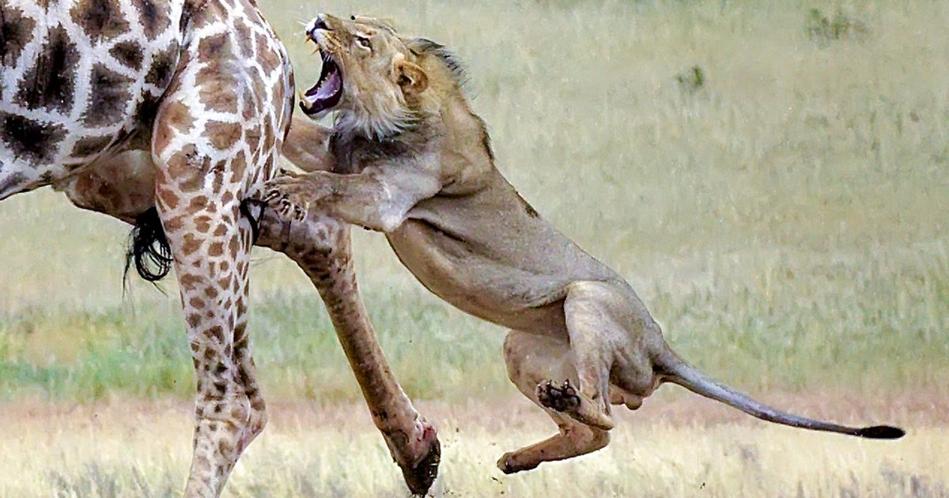
ADAMWHITE

Slide 12
LION LEADERSHIP LESSON #2:
SPEED
ADAMWHITE

Slide 13
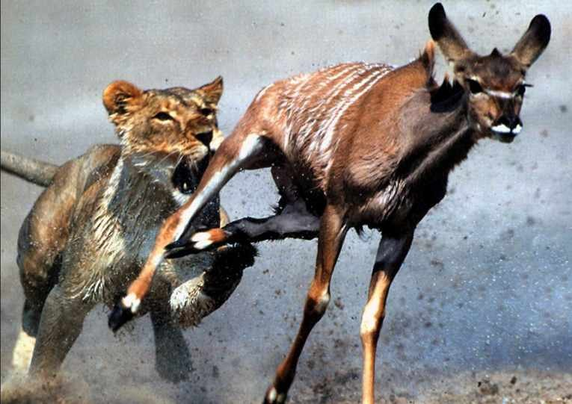
ADAMWHITE

Slide 14
LION LEADERSHIP LESSON #3:
MINDSET
ADAMWHITE

Slide 15
The Distinction of LEADERSHIP
THE DIFFERENCE BETWEEN A LEADER AND OTHERS IS…
MINDSET
ADAMWHITE

Slide 16
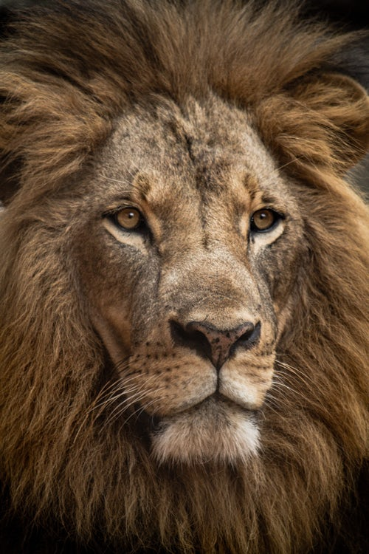
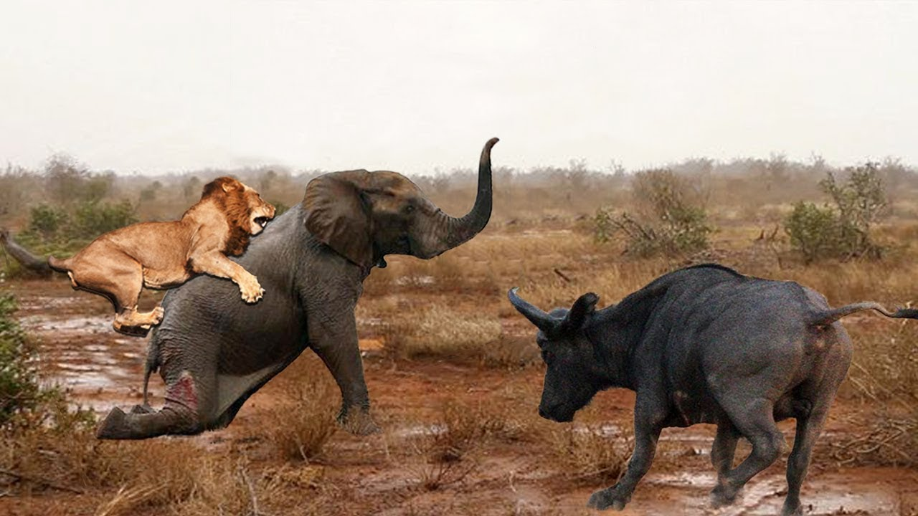
ADAMWHITE

Slide 17
Leader vs. Manager Mindset
“MANAGERS THINK OF THE NEXT POSITION”
“LEADERS THINK OF THE NEXT GENERATION”
“MANAGERS HAVE A SHORT TERM VIEW”
“LEADERS HAVE A LONG TERM VIEW”
“A MANAGER THINKS ABOUT THE BOTTOM LINE”
“A LEADER THINGS ABOUT THE HORIZON|VISION”
“MANAGERS DON’T WANT TO ROCK THE BOAT”
“LEADERS TURN THE BOAT OVER AND BUILDS AN NEW ONE”
ADAMWHITE

Slide 18
LION LEADERSHIP LESSON #4:
ASSOCIATION
ADAMWHITE

Slide 19
LEADERSHIP ASSOCIATION
A LEADER LEADS A NARROW, DISCIPLINED LIFE
ASSOCIATION REFLECTS LEADERSHIP LEVEL
ADAMWHITE

Slide 20
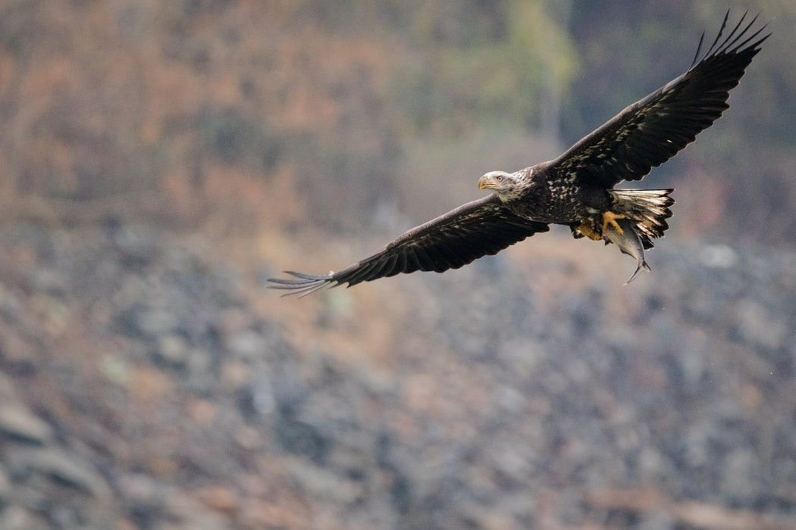
ADAMWHITE

Slide 21
LION LEADERSHIP LESSON #5:
DEVELOPS FOLLOWERS INTO LEADERS
ADAMWHITE

Slide 22
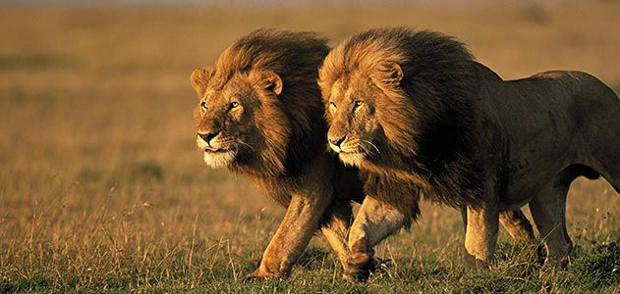
ADAMWHITE

Slide 23
Employ vs. Deploy
AVERAGE LEADERS
“EMPLOY” PEOPLE
INFLUENTIAL LEADERS
“DEPLOY” PEOPLE
(Release people to become themselves)
ADAMWHITE

Slide 24
LION LEADERSHIP LESSON #6:
PROVIDES PROTECTION
ADAMWHITE

Slide 25
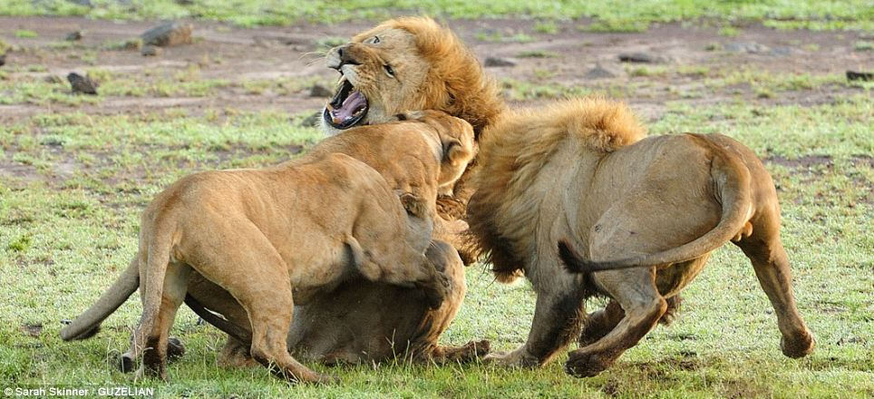
ADAMWHITE

Slide 26
LION LEADERSHIP LESSON #7:
DEVELOPS A
“ONE TEAM” CULTURE
ADAMWHITE

Slide 27
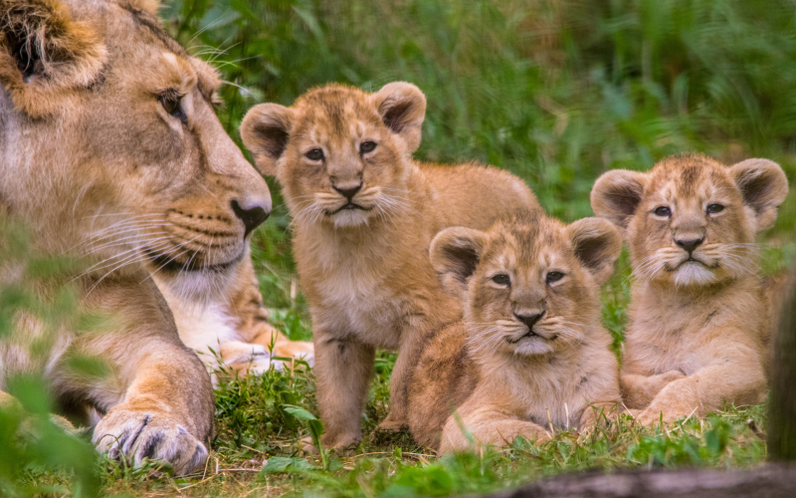
ADAMWHITE

Slide 28
INFLUENTIAL LEADERSHIP
ADAMWHITE

Slide 29
What leadership is not…
LEADERSHIP IS NOT A “TITLE”
LEADERSHIP IS NOT A “POSITION”
LEADERSHIP IS NOT “AUTHORITY”
ADAMWHITE

Slide 30
LEADERSHIP = INFLUENCE
ADAMWHITE

Slide 31
Influential leadership Starts Inside
Self-Discipline – Your Daily Habits are a Reflection of Your Discipline. Thought life Management.
Overcoming Your Own Fears – Fear is A Mental Construct, But I am Real.
Managing Internal Conflicts – Staying true to your values & beliefs.
Intentional Growth & Personal Development – Intentional and Focused on Continuous Growth and Improvement inside.
ADAMWHITE

Slide 32
If a Leader doesn’t Master Character Problems…
“BLOCK THE BRILLIANCE OF A GREAT LEADER”
ADAMWHITE

Slide 33
Leadership Philosophy:
LEAD BY PERMISSION NOT POSITION
ADAMWHITE

Slide 34
LEAD BY PERMISSION
PEOPLE GRANT THEIR PERMISSION FOR YOU TO LEAD THEM
LEADERSHIP PERMISSION IS A TRUST
NO ONE IS OBLIGATGED TO FOLLOW YOU
ADAMWHITE

Slide 35
Leadership RULES
DON’T BREAK THEIR TRUST
DON’T LORD OR RULE OVER PEOPLE
DON’T MISTREAT THEM
“Leadership and the Little Boy”
ADAMWHITE

Slide 36
LEAD BY PERMISSION
You Lead out of your LIFE, not your Position
The position doesn’t make you a Great Leader, but you have to bring Great Leadership to the position.
2 Types of Leadership
Position or Permission Based
ADAMWHITE

Slide 37
LEVEL 1 Leadership – Position Level:
People follow you because they “have” to.
Results:
Least amount of effort
Least amount of energy, time, mind, abilities & talent.
High turnover & low retention rates and low moral
ADAMWHITE

Slide 38
LEVEL 2 Leadership – Permission Level:
People follow you because they “want” to. (relationship)
Leader has developed “likability factor”
Results:
Best effort
Maximum energy, time, mind, abilities & talent.
Engaged & motivated. Improved retention rates.
ADAMWHITE

Slide 39
WHAT ARE THE
CHARACTERSITICS
OF
AN INFLUENTIAL LEADER?
ADAMWHITE

Slide 40
PATIENCE – to show “self-control” (impulse control) being consistent and predictable in mood and actions. Acting out in anger violates the rights of others, and is in appropriate and damages relationships.
KINDNESS – “to give attention, appreciation and encouragement to people.” To display common courtesy to others.
HUMILITY- displaying an absence of pride, arrogance or pretense.
ADAMWHITE

Slide 41
FORGIVING- understands that people are imperfect. Possessing a willingness to forgive mistakes.
HONEST- lives a lifestyle of integrity and develops a habit of being honest when no one is looking.
COMMITMENT – committed to the mission and also committed to developing others. Demonstrates a “no-quit” attitude, and is consistent in leadership efforts.
ADAMWHITE

Slide 42
THANK YOU!
GET A SIGNED COPY TODAY!
VISIT
adamwhitespeaks.com
For Online Training Courses, Free PDF’s Vblog tips, books and more
ADAMWHITE

Slide 43
Thank You!
Connect with Adam…
Facebook: @AdamWhiteSpeaks
Twitter: @adamwhitespeaks
YouTube: Adam White Channel
LinkedIn: Adam H. White III
Web: adamwhitespeaks.com
Text Your Name & Email Address to:
(734) 756-9114

