Slide 1
People centric Communication
[ Client | Date ]

Slide 2
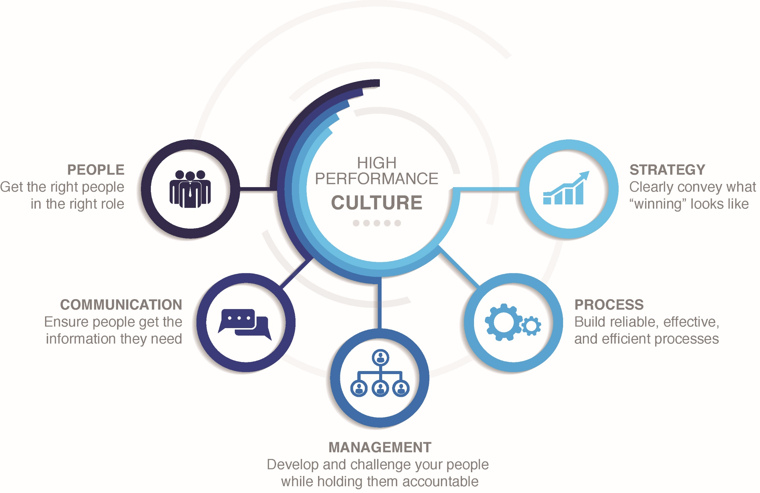

Slide 3
Communication
Ensure people get the information they need.

Slide 4
Impact of Communication
Communication influences everything we do on a day to day basis
Breakdowns in communication cause confusion, lost time, and misalignment between teams
When we understand each other, we know what we are doing, why we are doing it, who is going to do it, and how to do it

Slide 5
We have so many methods of communication and more access to each other than ever before.

Slide 6
methods of communication
Email & Text
Social Media & Video Conferencing
Meetings
Performance Appraisals
“Can I talk to you for a second?”
Non-verbal communication

Slide 7
Why isn’t everyone getting the information they need to succeed?

Slide 8
Communication misconceptions
Messages are unidirectional
Communication implies shared understanding
Listening is the same as hearing
Our communication styles are the same.

Slide 9
Where does communication break down for you?

Slide 10
Communication Styles
Creating a common language to understand your communication style and the communication styles of others.

Slide 11
activity

Slide 12
What Style Are You?
For each statement, rank yourself by filling out the numbers as follows:
(4) This MOST describes you
(3) Then, the next most one that describes you
(2) Then, the next most
(1) This LEAST describes you
Use each number only once for each statement and be sure to use all numbers. Even if you can’t decide, you must rank them anyway.

Slide 13
Scoring Your Style
Transfer your answers onto the scoring sheet
Note that the scoring guide does NOT always go in ABCD order

Slide 14
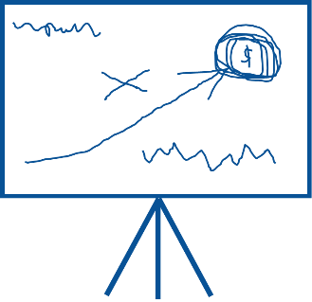
Communication Styles
The Go-Getter
Place a high value on action and thrive on getting things done in the here and now.
The Empathizer
Place high value on human interaction and are attracted by jobs or situations in which social-interpersonal contacts with others are highly likely.
The Outliner
Place a high value on logic, ideas, and systematic inquiry.
The Whiteboard User
Place a high value on ideas, innovation, concepts, theory and long-range thinking.

Slide 15
How do you communicate with others?
Notes:
Get with your group.

Slide 16
How do you prefer others communicate with you?
Notes:
Get up with groups.

Slide 17
The Go-Getter
Talks too fast
Direct in dialogue
Ready to solve the problem

Slide 18
The Go-Getter
“What doesn’t make sense to you?”
“What will this cost?”
“Let’s try it.”

Slide 19
The empathizer
People first.
Defends actions of others
Uses your name

Slide 20
The empathizer
“I feel…”
“How will this affect our people?”
“That reminds me of the time we…”

Slide 21
The Outliner
List makers
Offers and wants all of the details
Noncommittal under stress or change

Slide 22
The Outliner
“What options do we have?”
“Give me some details…”
“How can you support that? Tell me more.”

Slide 23
The Whiteboard User
Thinks big picture
References future events
Leaves issues dangling, specifically when stressed

Slide 24
The Whiteboard User
“What are the long term implications?”
“What if…”
“Here’s a twist…”

Slide 25
Communicating with others

Slide 26
Which of these styles do you come into the most conflict with?

Slide 27
How can you modify your style to more effectively communicate with another style?

Slide 28
Communicating with a Go-Getter
Ask them to unpack their positions
Freedom to think and guardrails to act
Coach them to listen and slow down

Slide 29
Communicating with an empathizer
Listen but do not coddle
Acknowledge how your decision is going to affect others
Emphasize the big picture rather than individual perspectives

Slide 30
Communicating with an Outliner
Give them time to think
Build strict guardrails around what information is relevant
Give a deadline for making decisions

Slide 31
Communicating with a Whiteboard user
Timelines and deadlines
Freedom to think
Emphasize the importance of results as opposed to the process of ideation

Slide 32
People centric communication
Communicating in a High Performance Culture.

Slide 33
Understand your style
Reflect on your daily conversations
How do you react under stress?
Your best day at work:
How did people communicate with you?
How did you communicate with people?

Slide 34
Acknowledge others styles
Ask questions
Actively listen & recognize body language
Provide information in multiple ways
“What is the best way I can communicate this to you?”
Notes:
Multiple options for providing information
For example, efficient (go-getter) email
Share the big picture (whiteboard) and add an attachment with an agenda and the details (outliner).
Address each person’s name (empathizer).

Slide 35
Effective communication only happens when you know you might be wrong.

Slide 36
collaboration
Build trust and create a safe ‘Place’ (i.e. meetings) to share ideas and find outcomes
Seek strategies that integrate and manage those styles to achieve the desired outcome
Communicate with your supervisors and co-workers during evaluations and meetings

Slide 37
Healthy conflict is necessary
Healthy conflict challenges the status quo and open up opportunities to improvements
To solve problems, we all have to be willing and able to communicate our reasons, ideas, and arguments with each other

Slide 38
Questions?

