Slide 1
How to Lead Health Care in a Time of Uncertainty
Kent Bottles, MD
Apr
A
ApCColorado MGMA Conference, September 13, 2012

Slide 2
The Presentation
Leaders experience the current health care environment as chaotic, uncertain, & unpredictable
Cost of health care is not sustainable
ACA fate under Trump Administration
Population Health vs. Hospitalization
Threat of industry disruption by Uber for healthcare
Physician Burnout and Uncertainty
How to lead, innovate, and take care of patients in an era of uncertainty

Slide 3
Tension Between 2 Eras of Medicine
Don Berwick, JAMA, 2016; 315(13):1329
First era of medicine where society conceded to the medical profession a privilege most other work groups do not get: the authority to judge the quality of its own work.
Unexplained variation in physician practice, high rates of medical injury from errors in care, and social and racial disparities challenged the wisdom of the above privilege
Second era dominated by rewards, punishments, and pay for performance
This collision of norms lies at root of physician burnout and inability to get physicians to engage in second era

Slide 4
US Health Care is in Purgatory
Paul Keckley, April 23, 2017
Is health care a fundamental right or privilege?
Why do we spend so much for such poor outcomes?
Should health care be available anytime, anywhere, and free?
Physicians are well paid, trusted, and burnt out
Need more clinicians but guilds control access
Do not spend adequately on social determinants
Politicians don’t confront difficult healthcare issues
We endorse affordability but shun cost transparency

Slide 5
Health Care’s Future Is Uncertain
How can we predict what will happen next?
Should our practice stay independent or become employees of an integrated delivery system?
How can we plan for what we should do? And what should we stop doing because the incentives are changed?
How can we deal with the anxiety we all feel?
How can we lead our organization?
Which consultant could advise us wisely?
Should I retool my organization to receive value based payments or continue to emphasize fee for service arrangements? What are pros and cons of waiting?

Slide 6
Tolerance of Uncertainty
https://www.sciencedirect.com/science/article/pii/S0277953617301703
“The set of negative and positive psychological responses — cognitive, emotional, and behavioral — provoked by the conscious awareness of ignorance about particular aspects of the world”

Slide 7
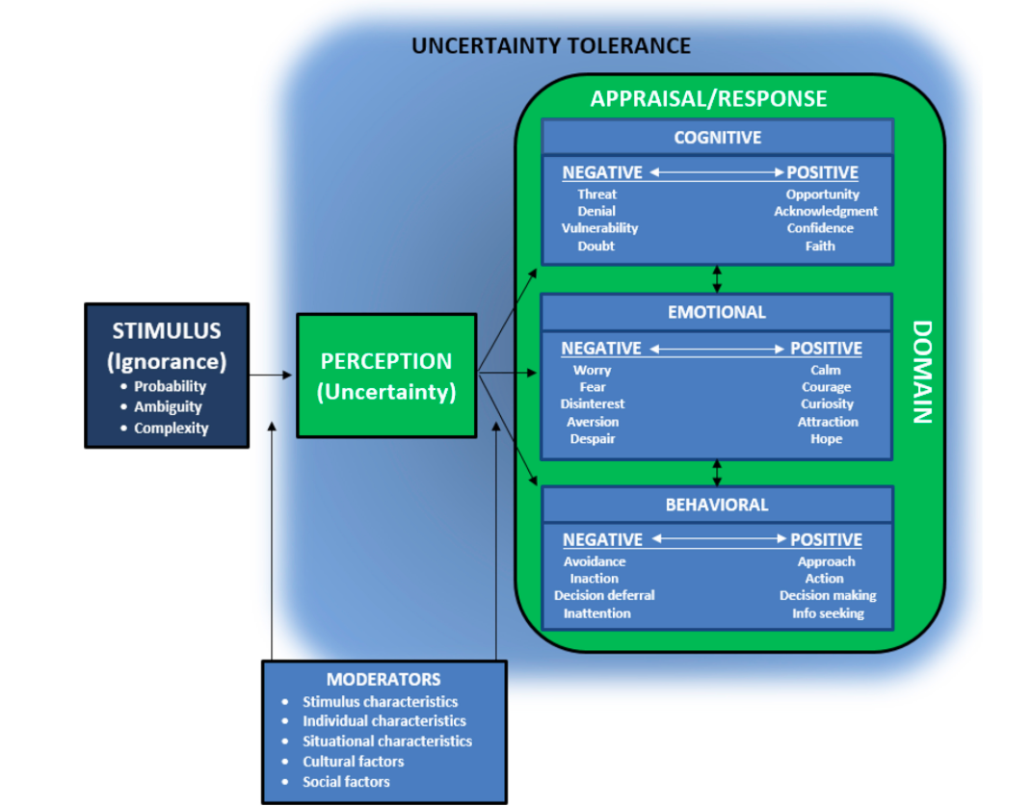

Slide 8
How Uncertainty Fuels Anxiety
Julie Beck, The Atlantic, March 18, 2015
Humans prefer certainty to uncertainty
People prefer definite shock now vs. uncertain shock in future
Greater nervous system activation when waiting for unpredictable shock than an expected one
People differ in the degree to which uncertainty bothers them and it can be measured by the Intolerance of Uncertainty Scale (IUS)

Slide 9
How Uncertainty Fuels Anxiety
Julie Beck, The Atlantic, March 18, 2015
High IU linked to anxiety disorders
Brain processes for emotional regulation (prefrontal cortex), threat detection, safety detection (amygdala) linked to IU via the insula
“What’s unique about humans is the ability to reflect on the fact that these future events are unknown or unpredictable. Uncertainty itself can lead to a lot of distress for humans in particular.” Dan Grupe, University of Wisconsin

Slide 10
Uncertainty Is Not Going Away:
So Now What Do We Do? How Can We Lead?

Slide 11
Intuition At Work
Gary Klein, 2003
The source of uncertainty
The types of tactics available for handling uncertainty
Decision maker’s personal tolerance for ambiguity

Slide 12
Types of Uncertainty
Gary Klein, 2003
Missing important information
Distrust the information you have
Have information, trust it, but it is inconsistent
Noise (irrelevant information)
Have, trust, consistent, relevant information but you are uncertain because it is too complex to interpret

Slide 13
Uncertainty Management Tactics
Gary Klein, 2003
Delay
Seek more information
Fill gaps with assumptions; entertain competing hypothesis
Build an interpretation
Press on
Shake the trees
Design decision scenarios
Simplify the plan
Plan for the worst
Use incremental decisions
Embrace the uncertainty

Slide 14
PreMortem
Gary Klein, 2003
Find key vulnerabilities in a plan
Imagine total, embarrassing, devastating failure
Generate reasons for failure individually
Consolidate list of failures
Revisit the plan to address how to avoid list
Periodically review the list

Slide 15
Ways Emotionally Intelligent People Overcome Uncertainty
Travis Bradberry, PhD
Quiet limbic system
Stay positive
They know what they know and what they don’t
Embrace what cannot be controlled
Focus only on what matters
Don’t seek perfection
Don’t dwell on problems
Know when to trust their gut
Contingency plans
Breathe

Slide 16
Antifragile: How to Live in a World We Don’t Understand
Nassim Nicholas Taleb, 2012
Black Swan event: rare, large impact, causes retrospectively identified; impossibility of calculating the risks of rare events and predicting their occurrence
We know a lot more about what is wrong than what is right; experts and others don’t know what they don’t know; it is human nature to be overconfident
What we know today might turn out to be wrong, but what is wrong today cannot turn out to be right tomorrow
If I spot a black swan, I can be sure that the statement “all swans are white” is wrong
Since one small observation can disprove a statement, while millions cannot confirm it, disconfirmation is more rigorous than confirmation (Sir Karl Popper)

Slide 17
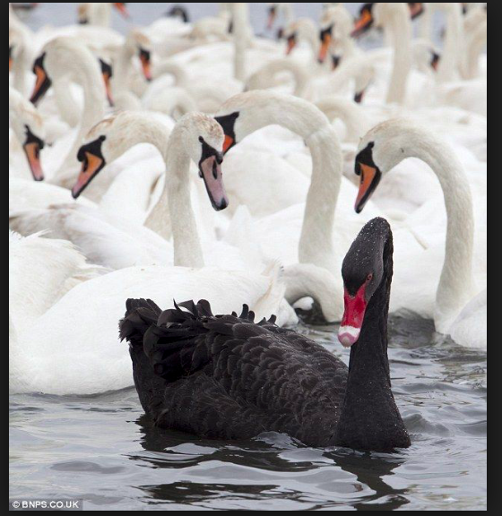

Slide 18
Stoicism as Response to Uncertainty
“An intelligent life is all about emotional positioning to eliminate the sting of harm…which is done by mentally writing off belongings so one does not feel any pain from losses. The volatility of the world no longer affects you negatively.” Nassim Taleb
Read Seneca, Zeno of Citium, Epictetus, Marcus Aurelius, Albert Ellis, Aaron Beck, Victor Frankl
“It’s not the events that upset us, but our judgments about the events.” Epictetus

Slide 19
Martha Nussbaum
“To be a good human is to have a kind of openness to the world, an ability to trust uncertain things beyond your own control, that can lead you to be shattered in very extreme circumstances for which you were not to blame. That says something very important about the ethical life: that it is based on a trust in the uncertainty, and on a willingness to be exposed. It’s based on being more like a plant than a jewel: something rather fragile, but whose very particular beauty is inseparable from that fragility.”

Slide 20
Antifragile: How to Live in a World We Don’t Understand
Nassim Nicholas Taleb, 2012
Human beings are better at doing things than we are at thinking (techne > episteme); Academy favors episteme > techne.
Jet engines were developed by tinkering engineers without understanding of how they works rather than by physicists applying a scientific theory. Text books are wrong.
Most innovations do not result from applying theory to practice

Slide 21
Tacit Knowledge
“Involves knowing how to manage yourself and others, and how to navigate complicated social situations with emotional intelligence” Richard Wagner
Knowledge that cannot be easily summarized or conveyed; specific to a place or job or experience; the person closer to problem should solve problem Friedrich Hayek
Fuzzy stuff around the edges – context, background, history, common knowledge. Xerox repairmen learn more from coffee breaks than manual Brown & Duguid

Slide 22
Uncertainty & Trust in Medicine
Katrina Armstrong, Annals of Internal Medicine, April 17, 2018
AI tries to eliminate uncertainty in decision making
Discomfort of uncertainty can have a positive effect on medical care through the physician/patient relationship
Trust is the belief that another person will act in your interest in the future; Much of anxiety due to lack of trust in institutions
Appropriate transparent expressions of uncertainty can lead to a stronger physician patient relationship
Greatest comfort to a patient can be hearing that regardless of clinical uncertainty their physician will be with them no matter what the future holds

Slide 23
Uncertainty
“Uncertainty is the only certainty there is, and knowing how to live with insecurity is the only security.” John Allen Paulos
“Madness is the result not of uncertainty but of certainty” F. Nietzche
“The trouble with the world is that the stupid are so confident while the intelligent are full of doubt.” Bertrand Russell
"No matter how much evidence exists that seers do not exist, suckers will pay for the existence of seers." J. Scott Armstrong
“Use trial & error and tinkering rather than planning to co-create with your patients innovations that cannot be predicted so that neither you nor your patients nor your organization turn out to be turkeys in a time of chaos and uncertainty.” Kent Bottles

Slide 24
How Bad Is MD Burnout?
http://www.massmed.org/News-and-Publications/MMS-News-Releases/Physician-Burnout-Report-2018/
Half of all physicians experience burnout in some form
Merritt Hawkins survey 78% experience feelings of professional burnout
Increase of 4% from 2016 survey

Slide 25
Mayo Strategies to Promote Engagement & Reduce Burnout
Mayo Clin Proc January 2017:92(1):129-146
Declining reimbursements
EHR requirements costly & increase clerical burden
Increase productivity expectations for MDs
Improve efficiency
Expense reductions to decrease cost of care
MDs must be engaged, nimble, resilient, invested in helping organization support triple aim

Slide 26
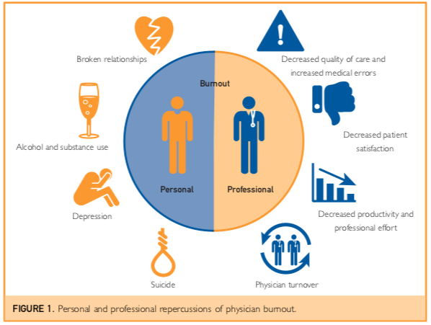

Slide 27
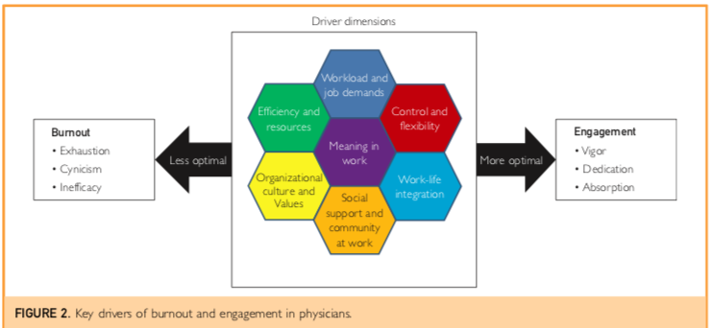

Slide 28
Mayo Strategies to Promote Engagement & Reduce Burnout
Acknowledge and Assess the problem
Town halls, radio broadcasts, letters, video, face to face meetings with CEO
Measure physician wellbeing as routine institutional performance metric compared to national benchmarks and reported to board

Slide 29
Mayo Strategies to Promote Engagement & Reduce Burnout
Harness the power of leadership
2013 study of 2800 MDs found 1-point increase in leadership score (60 point scale) associated with 3.3% decrease in burnout and 9% increase in satisfaction
11% of variation in burnout and 47% of variation in satisfaction between work units explained by leadership rating of supervisor
Physicians who spend at least 20% of professional effort on most meaningful kind of work lower risk of burnout

Slide 30
Mayo Strategies to Promote Engagement & Reduce Burnout
Develop & Implement Targeted Interventions
Burnout varies by specialty and work unit
Work unit with burnout rates > national average and satisfaction below 50th percentile identified
Leadership consulting team, focus groups, work unit leader facilitates changes
7 units 11% absolute reduction in burnout (range 4% to 46%)

Slide 31
Mayo Strategies to Promote Engagement & Reduce Burnout
Cultivate community at work
Peer support casualty of increased efficiency
Dedicated meeting area with free food, computers
COMPASS (Colleagues Meeting to Promote And Sustain Satisfaction) meal every 2 weeks to discuss virtues and challenges of being MD

Slide 32
Mayo Strategies to Promote Engagement & Reduce Burnout
Use rewards and incentives wisely
MDs increase productivity by less time with patient, ordering more tests, working longer
Simple financial incentives may back fire
Behavioral economics inform ways to provide incentives

Slide 33
Mayo Strategies to Promote Engagement & Reduce Burnout
Align values and strengthen culture
“The needs of the patient come first”
All staff survey to assess how we live our values
Physician feedback that Mayo had erosion of commitment to its staff
18 month task force resulted in 95% of physicians endorsing report and solutions
Document used for recruiting and on boarding

Slide 34
Mayo Strategies to Promote Engagement & Reduce Burnout
Promote Flexibility and Work-Life Integration
45% of MDs work >60 hours a week compared to 10% of other workers
Allow part time appointments
Flexible hours

Slide 35
Mayo Strategies to Promote Engagement & Reduce Burnout
Promote Flexibility and Work-Life Integration
45% of MDs work >60 hours a week compared to 10% of other workers
Allow part time appointments
Flexible hours

Slide 36
Mayo Strategies to Promote Engagement & Reduce Burnout
Provide resources to promote resilience and self care
Unless coupled with structural changes met with cynicism by physicians
Mindfulness

Slide 37
Mayo Strategies to Promote Engagement & Reduce Burnout
Facilitate and Fund Organizational Science
Mayo Clinic Program on Physician Well Being
Launched in 2007
Develop new metrics, national benchmarks, practice analytics, conducting intervention studies and randomized trials
100 peer reviewed publications
Chief Wellness Officer

Slide 38
Engaging Doctors in the Health Care Revolution TH Lee & T Cosgrove, HBR
Noble shared purpose
Self interest
Respect
Tradition

Slide 39
Engaging Doctors in the Health Care Revolution TH Lee & T Cosgrove, HBR
Noble shared purpose
Shifts conversation from negative to positive
Acknowledge need for sacrifice
Duty to patients preempts other obligations
Urology patient story at Cleveland Clinic 2008
Advocate huddles lead to 40% increase in safety event reports
Mayo Clinic: “The needs of the patient come first”
Patients come first
Status quo is unsustainable
Group action is needed to pursue patient first goal

Slide 40
Engaging Doctors in the Health Care Revolution TH Lee & T Cosgrove, HBR
Self-interest
Compensation plans tied to citizenship, quality
One year renewable contracts
Watch for conflicts of interest
Reward collaboration

Slide 41
Engaging Doctors in the Health Care Revolution TH Lee & T Cosgrove, HBR
Tradition
Mayo Clinic dress code
Physician communication standards
Organization must be willing to part ways with physicians who don’t support shared purpose

Slide 42
Engaging Doctors in the Health Care Revolution TH Lee & T Cosgrove, HBR
Respect
Behavioral economics, peer pressure, transparent data
Partners unmasked data on MD use of imaging led to 15% drop in orders for high cost tests
University of Utah transparent patient experience ratings utilized gradual introduction

Slide 43
From Triple Aim to Quadruple Aim
http://www.annfammed.org/content/12/6/573.full
“The joy of practicing medicine is gone.”
“I hate being a doctor…I can’t wait to get out.”
“I can’t tell you how defeated I feel…The feeling of being punished for delivering good care is nerve-racking.”
“I am no longer a physician but the data manager, data entry clerk and steno girl… I became a doctor to take care of patients. I have become the typist.”

Slide 44
From Triple Aim to Quadruple Aim
http://www.annfammed.org/content/12/6/573.full
Implement team documentation
Previsit planning to reduce wasted time with patient
Expand roles of nurses and medical assistants
Standardize & synchronize workflows for prescription refills
Colocate teams so MDs and staff work together
Train staff in new tasks

Slide 45
What Can We Do?
http://www.massmed.org/News-and-Publications/MMS-News-Releases/Physician-Burnout-Report-2018/
Support proactive mental health treatment and support for physicians experiencing burnout
Improved EHR standards with strong focus on usability and open APIs
Appoint executive level chief wellness officers at every major health care organization

Slide 46
Thomas Atchison’s Titled Executives (CTOs)
Begin Here
Financial Performers
TANGIBLES:
Clinical and business
processes account for
35% of
organizational
performance
These 3 elements
result from living the:
Strategic Plan
Departmental Plans
The Budget
Patient Safety
Clinical Quality
The Bridge Between
the Tangibles and
the Intangibles
The “X” Factor
The “Spirit” of
the organization
SYNERGY
Joy
THE DEEPER
DIMENSIONS
These 4 elements
are the source of a
sense of purpose
and meaningful work as
a result of living the
mission, values and
vision.
INTANGIBLES:
Human relations
account for 65% of
organizational
performance
Pride
Respect
Trust
Leaders (CLOs)
Begin Here

Slide 47
The Extended Disorder Family
Nassim Nicholas Taleb
Uncertainty, variability, imperfect knowledge, chance, chaos, volatility, disorder, entropy, time, the unknown, randomness, turmoil, stressor, error, dispersion of outcomes, unknowledge
“Our knowledge of the way things work, in society or in nature, comes trailing clouds of vagueness. Vast ills have followed a belief in certainty.” Kenneth Arrow, Nobelist in Economics
Mathematics do not perfectly represent the world and reality. One does not see triangles on hike.

Slide 48
Some Final Thoughts
“It is important to approach your health in general from a lack of understanding. Honor the body and its relationship to disease as a complex emergent system that you many never fully comprehend.” David Agus, MD
“There is a contradiction in wanting to be perfectly secure in a universe whose very nature is momentariness and fluidity.” Alan Watts
“When you try to stay on the surface of the water, you sink; but when you try to sink, you float…Insecurity is the result of trying to be secure…contrariwise, salvation and sanity consist in the most radical recognition that we have no way of saving ourselves.” Alan Watts

Slide 49
Michael Gazzaniga’s Left Brain Interpreter
Split brain patient shown two pictures
Right visual field sees chicken claw (Left hemisphere)
Left visual field sees snow scene (Right hemisphere)
Patient told to choose picture from array
Left hand picks shovel
Right hand picks chicken
Why? Claw goes with chicken and you need a shovel to clean out the chicken shed
Patient does not give the right answer which is I don’t know why I picked the shovel because you cut my brain in half and my left and right sides of my brain cannot communicate with each other

Slide 50
Appendix

Slide 51
Pre-ACA Problems
Cost (contribution to federal budget deficit)
Quality (rankings vs. other countries)
Access (Americans without insurance; rural areas)
Financial hardships (personal bankruptcy)
Small area variations of cost and quality
Shortages of PCP, mental health providers
Expensive & Uncertain Individual Markets

Slide 52
Antifragile: How to Live in a World We Don’t Understand
Nassim Nicholas Taleb, 2012
We know a lot more about what is wrong than what is right; experts and others don’t know what they don’t know; it is human nature to be overconfident
What we know today might turn out to be wrong, but what is wrong today cannot turn out to be right tomorrow
If I spot a black swan, I can be sure that the statement “all swans are white” is wrong
Since one small observation can disprove a statement, while millions cannot confirm it, disconfirmation is more rigorous than confirmation (Sir Karl Popper)

Slide 53
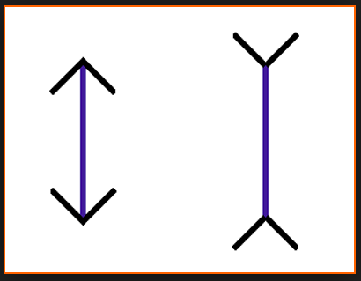

Slide 55
Antifragile: How to Live in a World We Don’t Understand
Nassim Nicholas Taleb, 2012
Black Swan event: rare, large impact, retrospectively causes identified; impossibility of calculating the risks of rare events and predicting their occurrence
Focus on fragility rather than prediction
Fragile, robust, antifragile
Fragile hates mistakes because irreversible & large
Robust values mistakes as information
Antifragile loves mistakes because they are small

Slide 56
Gaussian Wealth Distribution
Nassim Nicholas Taleb, The Black Swan, 2007
People with net worth > 1 million Euros: 1 in 62.5
> 2 million Euros: 1 in 127,000
> 4 million Euros: 1 in 886,000,000,000,000,000
> 8 million Euros: 1 in 16,000,000,000,000,000,000,000,000,000,000,000
> 16 million Euros: 1 in my computer does not handle the calculation

Slide 57
Scalable (Power Law) Wealth Distribution
Nassim Nicholas Taleb, The Black Swan, 2007
People with net worth > 1 million Euros: 1 in 62.5
> 2 million Euros: 1 in 250
> 4 million Euros: 1 in 1,000
> 8 million Euros: 1 in 4,000
> 16 million Euros: 1 in 16,000
> 32 million Euros: 1 in 64,000

Slide 58
The Power of Negative Thinking Atul Gawande, NY Times, May 1, 2007
“They tracked weekly data on injuries and survival rates, and actively looked for failures and how to overcome them.” Learn more from failures than successes
Better looking googles
Not wearing Kevlar
Transport problems
Death rate for American soldiers
First Gulf War: 25%
Iraq: <10%

Slide 59
The Digital Age
Exponential
“The greatest shortcoming of the human race is our inability to understand the exponential function” Albert A. Bartlett
Chess invented in sixth century CE, Gupta Empire
“Place one single grain of rice on first square of the board, two on the second, four on the third, and so on”
18 quintillion grains of rice; taller than Mt. Everest
Numbers so big they are inconceivable

Slide 60
Tacit Knowledge
“Involves things like knowing how to manage yourself and others, and how to navigate complicated social situations.” Richard Wagner
Knowledge that cannot be easily summarized or conveyed; specific to a place or job or experience; the person closer to problem should solve problem Friedrich Hayek
Fuzzy stuff around the edges – context, background, history, common knowledge. Xerox repair coffee breaks
Brown & Duguid

Slide 61
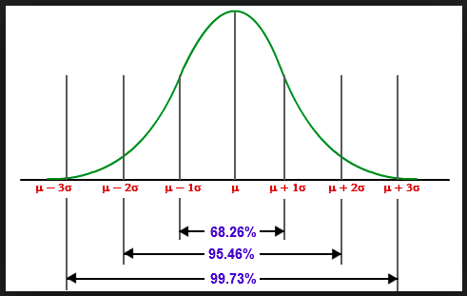

Slide 62
Scalable (Power Law) vs. Gaussian
Nassim Nicholas Taleb, The Black Swan, 2007
The rejection of the Gaussian paradigm is sufficient to reject the usual vision of the world
The Gaussian-bell curve estimates face a headwind that makes probabilities drop at a faster and faster rate as you move away from the mean
Scalable (Power Law) estimates do not have such a restriction
Mathematics do not perfectly represent the world and reality; they are approximations

Slide 63
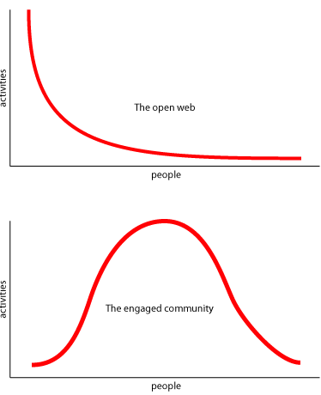

Slide 64
Linear vs. Nonlinear
Linear differential equations are modular: whole is exactly equal to sum of the parts. Incapable of modeling, representing rich complex behavior.
Nonlinear differential equations reflect competition or cooperation: whole is different from the sum of the parts. Capable of modeling rich, complex, chaotic behavior like life
Combination therapy for AIDS (3 drugs).

Slide 65
Antifragile: How to Live in a World We Don’t Understand
Nassim Nicholas Taleb, 2012
Predictions do not work in Black Swan rare event disasters domains
Can still make money predicting that some people will go bust because they ignore possible rare event because they use the wrong math equation
Focus on exposure to failures & what you don’t know, not what you know
A limit to knowledge that can never be reached no matter how sophisticated statistical and risk management science become
Asymmetry between effects of good and bad (risk aversion)
“An intelligent life is all about emotional positioning to eliminate the sting of harm…which is done by mentally writing off belongings so one does not feel any pain from losses. The volatility of the world no longer affects you negatively.” Read Seneca, Zeno of Citium, Epictetus, Marcus Aurelius

Slide 66
The Black Swan
Nassim Nicholas Taleb, 2007
“We are quick to forget that just being alive is an extraordinary piece of good luck, a remote event, a chance occurrence of monstrous proportions. Imagine a speck of dust next to a planet a billions times the size of the earth. The speck of dust represents the odds in favor of your being born; the huge planet would be the odds against it….remember that you are a Black Swan.”

Slide 67
Antifragile: How to Live in a World We Don’t Understand
Nassim Nicholas Taleb, 2012
January 1991 attacks Iraq to restitute Kuwait
Every analyst predicted rise in oil price if war
Trader did not take for granted that a scheduled war would cause rise in price of oil
He bet against the rise in price of oil
$300,000 investment became $18 million
In complex situations it is hard to ascertain what causes what

Slide 68
Antifragile: How to Live in a World We Don’t Understand
Nassim Nicholas Taleb, 2012
Antifragile: some things benefit from volatility, randomness, disorder, stressors, risk, and uncertainty
Antifragility allows us to deal with the unknown, to do things without understanding them by using heuristics
Human beings are better at doing things than we are at thinking (techne > episteme); Academy favors episteme > techne.
Jet engines were developed by tinkering engineers without understanding of how they works rather than by physicists applying a scientific theory. Text books are wrong.
Most innovations do not result from applying theory to practice

Slide 69
Antifragile: How to Live in a World We Don’t Understand
Nassim Nicholas Taleb, 2012
Guide to nonpredictive decision making during times of uncertainty
Anything that has more upside than downside from random events is antifragile; the reverse is fragile
A turkey unaware of Thanksgiving uses evidence to make rigorous future projections based on the past and concludes that the butcher/farmer who has fed him for the last 1000 days loves turkeys and that he, the turkey, will be alive December 1.
It is a mistake to regard the absence of evidence of harm for evidence of absence
The goal of life is not to become a turkey

Slide 70
Predictions
“There is not the slightest indication that nuclear energy will be obtainable.” Albert Einstein, 1932
“The telephone has too many shortcomings to be seriously considered as a means of communication” Western Union, 1876
“I think there is a world market for maybe 5 computers.” Thomas Watson, IBM Chair, 1943
“The world potential market for copy machines is 5000 at most” IBM to Xerox, 1959
"No matter how much evidence exists that seers do not exist, suckers will pay for the existence of seers." J. Scott Armstrong

Slide 71
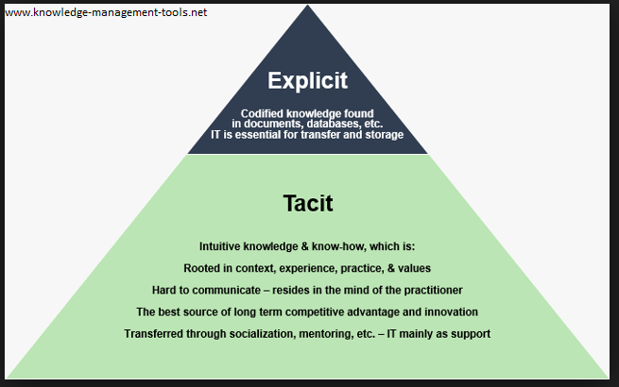

Slide 72
Trust, Doctor/Patient Relationship & Malpractice Law Suits
Plaintiff lawyer thinks relationship key factor in decision to file suits
P Moore, N Adler, P Robertson West J Med. 2000 Oct; 173(4):244-250. 104 postpartum UCSF OB patient study found direct causal effect of relationship on malpractice claim intention.
H Beckman, K Markakis, A Buchmann Arch Intern Med. 1994; 154(12): 1365-1370. Decision to litigate associated with perceived lack of caring.

